Slide 1

On-prem
Reimagine
data governance with Azure Purview
Multicloud
SaaS
Unified | Hybrid | Open

Slide 2
Azure Purview enables unified data governance
Reimagine data governance in the cloud
Set the foundation for effective data governance
Maximize business value of data for data consumers
Gain insight into data use across the estate

Slide 3




Data governance is becoming increasingly interdisciplinary
DISCOVERY
COMPLIANCE
What data do I have?
Where did the data originate?
Can I trust it?
What’s my exposure to risk?
Is my usage compliant?
How do I control access & use?
What is required by regulation X?
Chief Data Officer
Notes:
The idea is CDO lead the team to discover data and put that into one place you can start to answer high level question like what data do I have, how do I control acess & use?

Slide 4
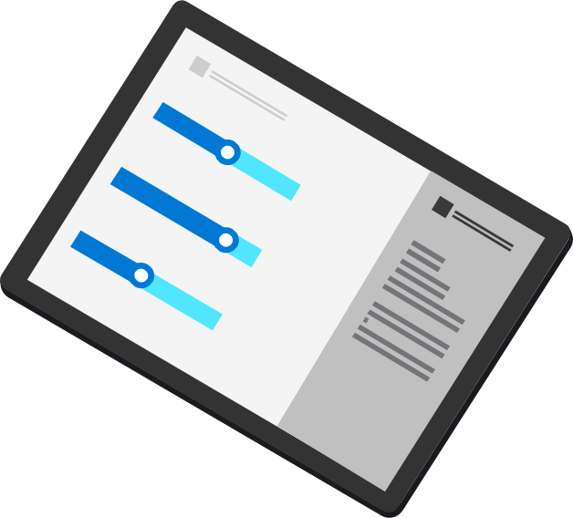
Azure Purview
Azure Purview
UNIFIED DATA GOVERNANCE
Data Insights
Data Map
Automate and manage metadata at scale
Data Catalog
Data Catalog
Enable effortless discovery for data consumers
On-prem
Multicloud
Data Map
Data Insights
Assess data usage across your organization
SaaS
Notes:
we create a data map. A data map is a Graph database of all your data assets present anywhere in the ecosystem. We represented the data inside of a graph using the Apache Atlas data model, which then connects different data assets together and then you can annotate those data assets through additional metadata about that data. This could be a business glossary, or a classification term, or sensitivity term.
The major innovation we’ve done here is the ability to scan and classify the data, so you can create the data map automatically, avoid the need to creating/managing catalog in a ad-hoc way.
Once you have the data map, users can start to interact with the data:
A business user can go to data catalog UI, knowing that data catalog is powered by data map underneath, you can search data assets
If you are a chief data officer who wants to know what’s inside your data catalog at a high level view, Insight tab will give you that view

Slide 5
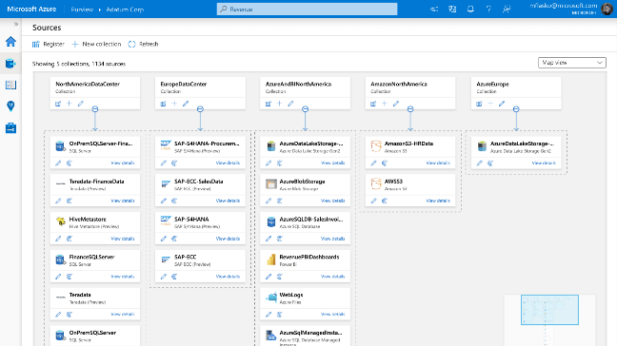
Unify and make data meaningful using Purview Data Map
Automated metadata scanning and lineage identification of hybrid data stores
100+ built-in and custom classifiers
Microsoft Information Protection sensitivity labels

Slide 6

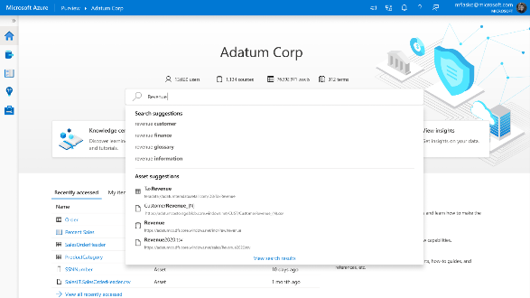

Enable effortless discovery with Purview Data Catalog
Semantic search and browse
Business glossary and workflows
Data lineage with sources, owners, transformations, and lifecycle

Slide 7
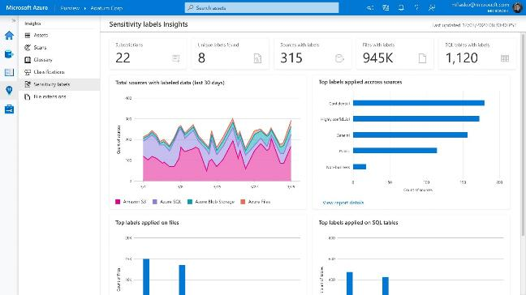
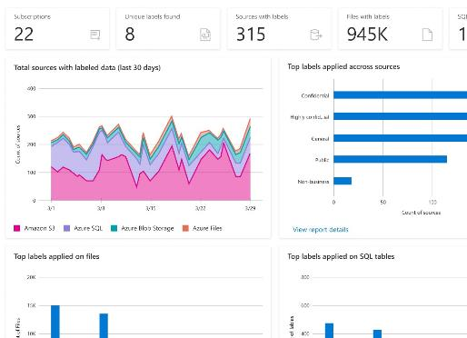

Get a bird’s-eye view of sensitive data with Data Insights
Reports on Assets, Scans, Glossary, Classification, and Labeling

Slide 8
Azure Purview: Unified Data Governance
Azure Purview
Power BI
SQL Server on-prem
Azure Synapse
Azure Data Services
M365 Compliance Center
Unified Experience
Data Catalog
Data Insights
Search
Business Glossary
Lineage
Data use reports
Publish, Discover & Curate Data
Unified Platform
“Data Map” = Data Assets | Lineage | Classifications
Open APIs
Automated Scanning & Classification
(Apache Atlas 2.0)
On-prem & Multicloud Operational, Analytical, SaaS
Notes:
Maximize business value of data with Azure Purview, a unified data governance solution, across operational and transactional data. Enable business and technical analysts to find, interpret and trust data with an intuitive catalog. Get insights and ensure data usage is governed within compliance guardrails.
Azure Purview is a unified data governance service. It organizes vast metadata that enables organizations to break down silos and derive meaning from data. Once data can be understood and annotated, it then lends itself to several applications – the first of which, we announced at public preview, being data catalog and data insights. In the future, privacy, quality and master data management value will follow.

Slide 9
Azure Purview Features at Public Preview
Azure Purview
Azure Purview Studio
Data Producers &
Consumers
Data Officers & Security Officers
Power BI
SQL Server on-prem
Azure Synapse
Azure Data Services
M365 Compliance Center
Azure Purview Catalog (C1)
Azure Purview Data Insights (D1)
Business Glossary templates
Lineage visualization & workflows
Catalog Insights (Asset, Scan, Glossary)
Sensitive Information Types & Labeling insights
Azure Purview Catalog included with Platform (C0)
Search, browse, asset details
Automated meta-data and lineage extraction
Automated classification based on content inspection
Private Endpoint
Management center
Azure Purview Platform
Data Map
Dedicated per customer on shared infra
Provisioned default capacity with option to add-on capacity
Automated Scanning & Classification
Open APIs
Serverless, pay per use
Includes connectors, scanning of sources, processing into data assets, lineage capture, classification
(Apache Atlas 2.0)
On-prem & Multi-cloud*
Operational, Analytical, SaaS*
* Power BI, SQL Sever on-prem, Azure Data Services including Synapse, Cosmos DB & Storage, Non-Microsoft systems including SAP ECC, SAP S4 HANA & Teradata, Multi-cloud systems including AWS S3
Notes:
With Purview Platform:
Automate scanning and classification of multicloud, SaaS, on-prem data. 25 plus out of box connectors and file formats supported
Modernize homegrown catalogs built on opensource technology with Babylon using Apache Atlas APIs supported out-of-the-box
Get catalog features (C0 Tier) for FREE included with Purview platform:
Search and browse
Empower business and technical data analysts via a catalog to find and interpret data.
Power data scientists and engineers with business context to drive BI, Analytics, AI and ML initiatives
Automated metadata and lineage extraction
Enrich the business value of data with technical, business and semantic metadata
Scale understanding of data with automated, fully managed, serverless metadata management capability
Leverage support of Apache Atlas’s open-source Lineage APIs to push lineage information into the Purview Data Map.
Analyze impact of changes to data and understand dependencies visually.
Azure Purview Catalog (C1 Tier) includes the following in addition to the free features included with the platform:
Business Glossary
Deliver a curated and consistent understanding of business terms and definitions.
Import existing glossary terms from existing data dictionaries easily.
Also add ability to define custom attributes for the glossary terms and create templates for different domains like ‘Finance’, ‘Sales’ etc.
Lineage views
Ensure data provenance with a visual representation of owners, sources, transformation, and lifecycle
Built-in integrations with solutions to automatically extract lineage such as Synapse Analytics, Azure Data Factory, Azure Data Share etc.
Data Insights (D1 Tier) provides a bird’s eye view of your data landscape intended to help users such as Chief Data Officers quickly understand their data estate at large and gain key insights such as where sensitive data resides. It includes:
Catalog insights:
Asset Insights: Quickly see where all your data resides across a range of data sources
Scan Insights: Success/failures/cancellations over a period
Glossary Insights: Quickly understand changes made to the glossary over time and assess how much coverage glossary has over your data map.
Sensitive data insights
Simplify compliance risk assessment across all your operational and transactional data sources.
Assess risk and derive audit trails of data qualified by sensitivity and business relevance.

Slide 10
Purview Data Map | Available Now | Coming Soon
Automated scanning of hybrid sources |  | AWS S3
Classification
Microsoft Information Protection Sensitivity Labels support
Apache Atlas API support
Purview Data Catalog
Semantic Search and Browse
Business Glossary |  | Hierarchical
Data Lineage
Purview in Azure Synapse workspaces
Purview data insights
Assets and Scans Reports
Glossary reports
Classification and Labelling Reports
Asset-level drill down by sensitivity
Azure Purview
Features*
* - Azure Purview and all features listed are in public preview
Notes:
This is a metadata management not master management, we inspect the contents and extract metadata. MDM requires metadata management though.

Slide 11

Azure Purview Studio (Unified Experience)

Slide 12
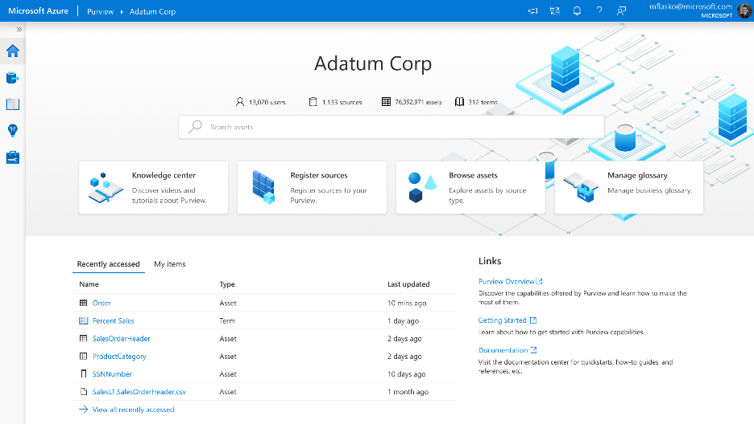
Azure Purview> Studio > Home
Purview Studio
A single, centralized place that provides unified experience for data producers, data consumers, data & security officers

Slide 13
Azure Purview> Studio > Home
Purview Studio
A single, centralized place that provides unified experience for data producers, data consumers, data & security officers

Slide 14
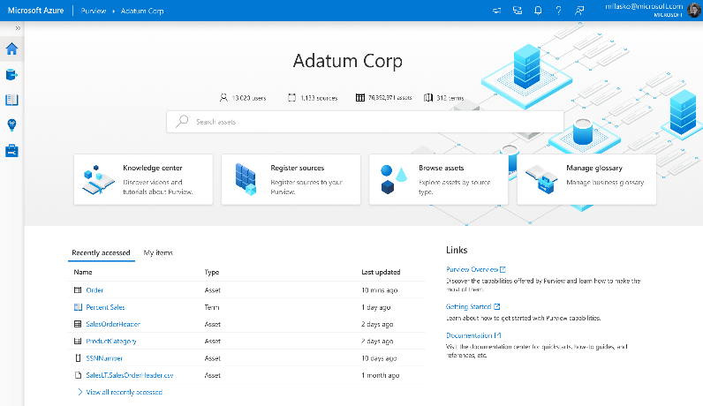
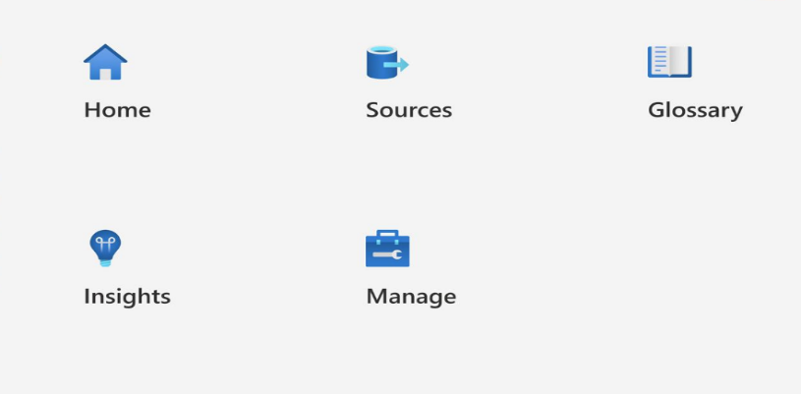
Purview Studio
Azure Purview> Studio > Home
Purview Studio divided into Activity hubs.
These organize the tasks needed for managing data governance activities
Quick actions, recently accessed items, owned items, search bar and documentations.
Create collections, register data sources and set up scans.
Manage glossary terms, search glossary terms, manage term templates and custom attributes, Import and export terms using .CSV.
Metadata management - classifications, resource sets, data sources, Integration run time, Alerts, Security, data factories and data share connections.
Get Insights on your data.

Slide 15
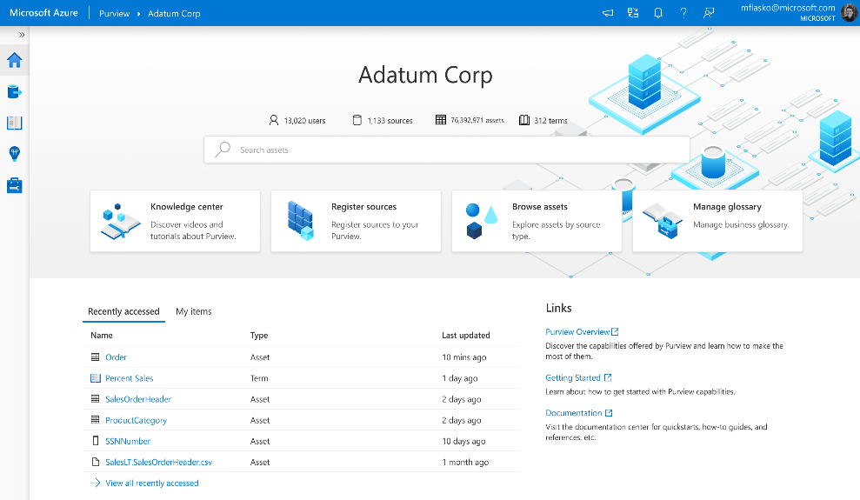
Purview Studio
Azure Purview> Studio > Home
Ease of access to get updates, to switch accounts, to get notifications and to provide feedback
Updates
Switch Accounts
Notifications
Feedback

Slide 16

Purview Studio Home Page

Slide 17

Azure Purview> Studio > Home
Home Page
Starting point for the activities with key links to tasks, artifacts and documentation based on user role
Catalog metrics
Search bar to browse and search data assets
Home page tiles for key activities
Recently accessed entities and list of entities owned by logged-on data user.
Links for Overview, getting started and purview documentation

Slide 18
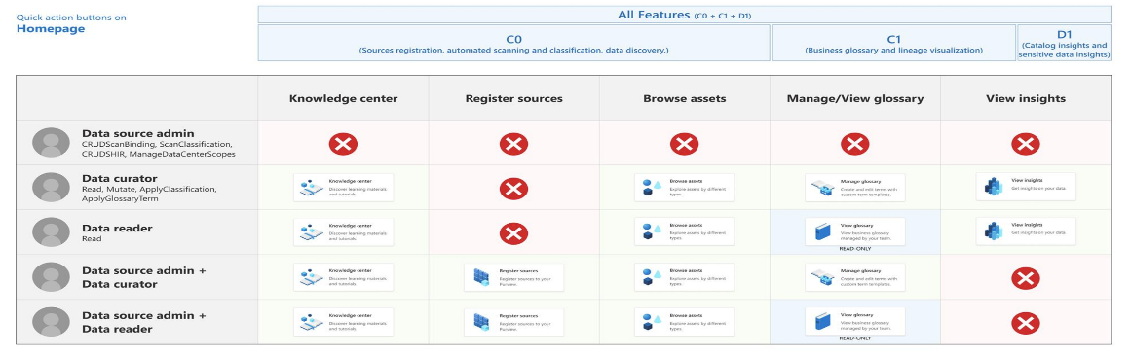
Azure Purview> Studio > Home
Home Page Activities
Home page key activities based on assigned user roles and selected purview tiers (C0, C1 & D1)
The home page quick access buttons (tiles) depend on the role assigned to the user.
For data curator, the buttons are Knowledge Center, Browse Assets, Manage Glossary and View Insights.
For data reader, the featured buttons are Knowledge Center, Browse Assets, View Glossary, and View Insights.
For data source administrator + data curator, the featured buttons are Knowledge Center, Register Data Sources, Browse Assets, and Manage Glossary.
For data source administrator + data reader, the featured buttons are Knowledge Center, Register Data Sources, Browse Assets, and View Glossary.
For data source administrator, no access to Purview Studio.
*Note: Only Owners and User Access Administrators can assign roles for Purview Studio in Azure portal.

Slide 19

Purview Platform Sources (Automated Scanning, Classification, Open APIs to populate the DataMap)

Slide 20
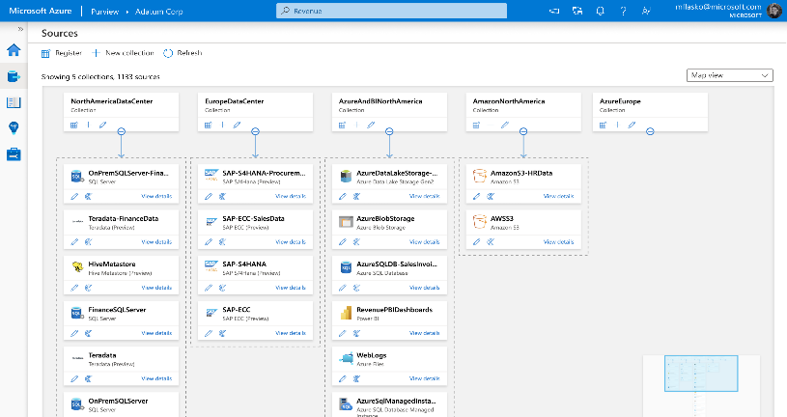
Azure Purview> Studio > Sources
Sources
Map your data to manage an enriched metadata map of operational and transactional data no matter where it lives
Benefits
Automated scanning of on-prem, multicloud, SaaS data
Discover Azure data sources, PowerBI, SQL better. Leverage turnkey integrations with Power BI, SQL (on-prem, azure, MI) and key Azure Data Services such as Azure Synapse, Cosmos DB, ADLS.
Manage metadata and scale understanding of data with automated, fully managed, serverless metadata management capability
Leverage Apache Atlas Open APIs to programmatically publish metadata and lineage from a wide range open-source data systems

Slide 21
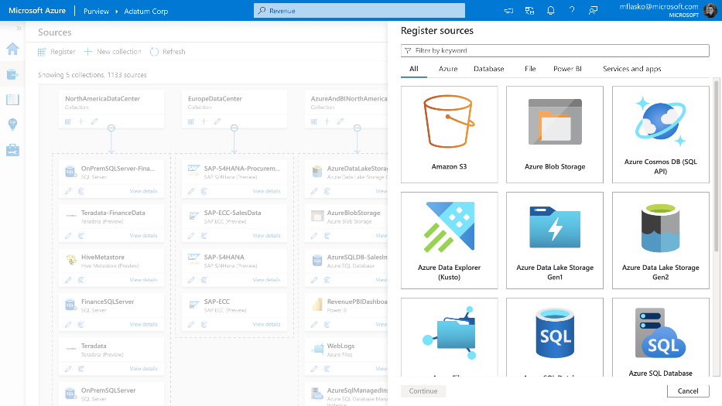
Azure Purview> Studio > Sources
Sources
Automated scanning & classification of on-prem, multicloud and SaaS data
Notes:
Automate the extraction from multicloud data sources including Azure, Amazon AWS
Extract metadata and lineage from SQL Server on-premises, SAP S4 HANA, Teradata and more
Modernize homegrown catalogs built on open source technology with Babylon using Apache Atlas APIs supported out-of-the-box
Leverage open APIs to programmatically publish metadata and lineage from a wide range open-source data systems

Slide 22
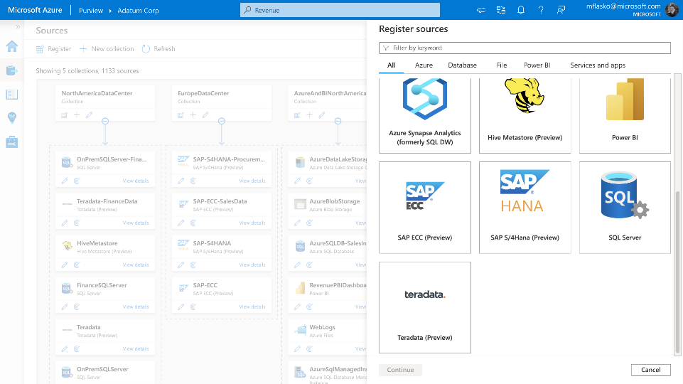
Azure Purview> Studio > Sources
Sources
Automated scanning & classification of on-prem, multicloud and SaaS data

Slide 23
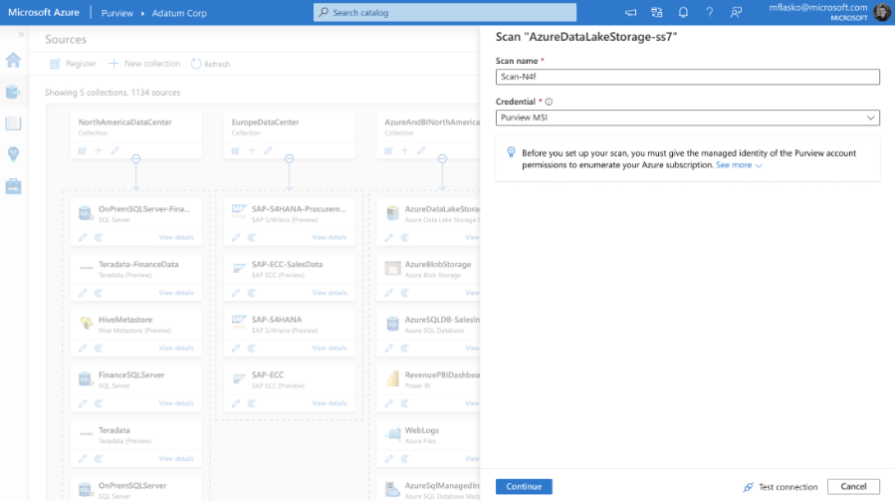
Azure Purview> Studio > Sources
Scan Sources
Set up scans to enrich business value of data with technical, business and semantic metadata

Slide 24
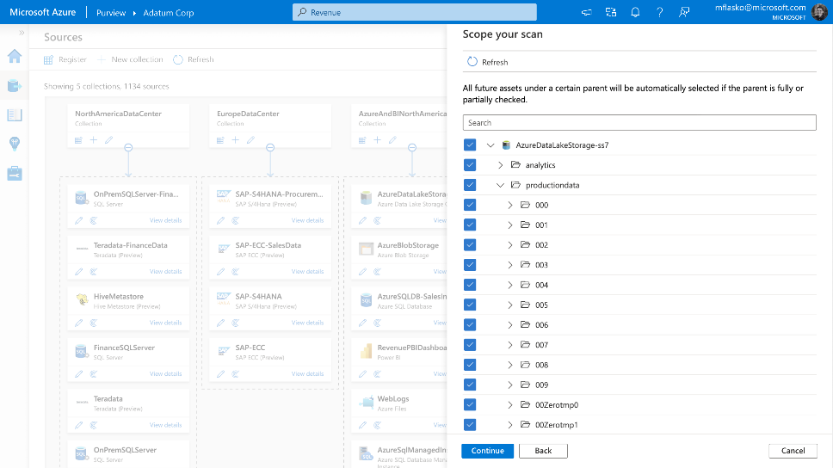
Azure Purview> Studio > Sources
Scan Sources
Scope your scan to select the entire storage account or few containers, files

Slide 25
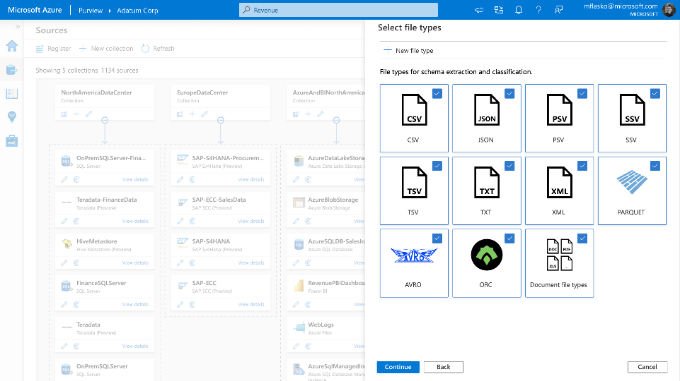
Azure Purview> Studio > Sources
Scan Sources
Select files types for scanning. Define custom file types
Custom File Type
Notes:
Define your own files types in your data lakes and make the automated scanners aware for scanning

Slide 26
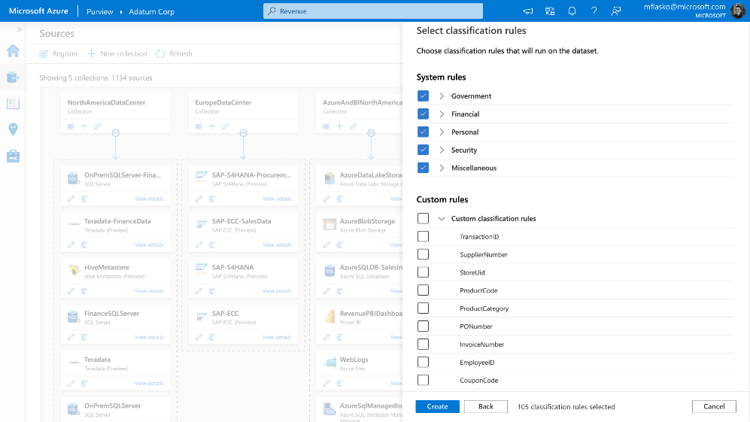
Azure Purview> Studio > Sources
Scan Sources
100+ built in classifiers, define your own custom classifiers
100 + out of box classifiers
Custom Classifiers
Notes:
Specify business value with terms, sensitivity, compliance, industry, and company-defined classifiers.
Use 100+ built-in classifiers shared between M365 and Purview, define your own custom classifiers, and Microsoft Information Protection sensitivity labels.

Slide 27
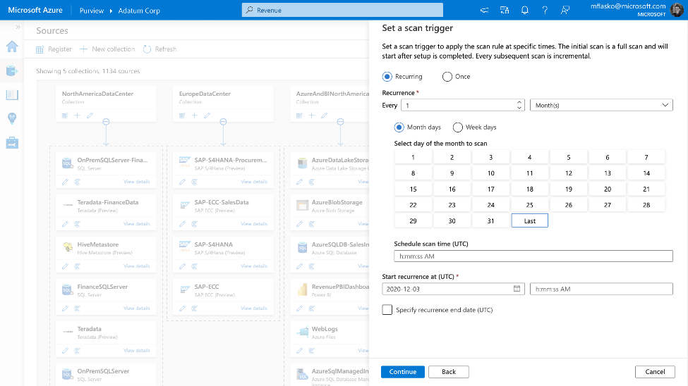
Azure Purview> Studio > Sources
Scan Sources
Run the scan one-time or on a schedule

Slide 28

Purview Catalog Browse & Search (Effortless discovery of trusted & accurate data)

Slide 29
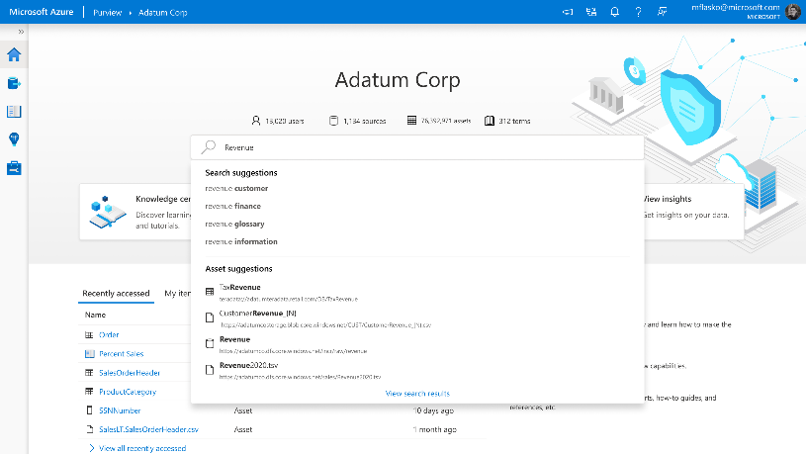
Azure Purview> Studio > Home
Browse & Search
Discover your data based on relevance using signals derived from scanning, classification, business context
Benefits
Empower business and technical data analysts via a catalog to find and interpret data
Provide intelligent recommendations based on data relationships, business context, search history
Power data scientists and engineers with business context to drive BI, Analytics, AI and ML initiatives

Slide 30
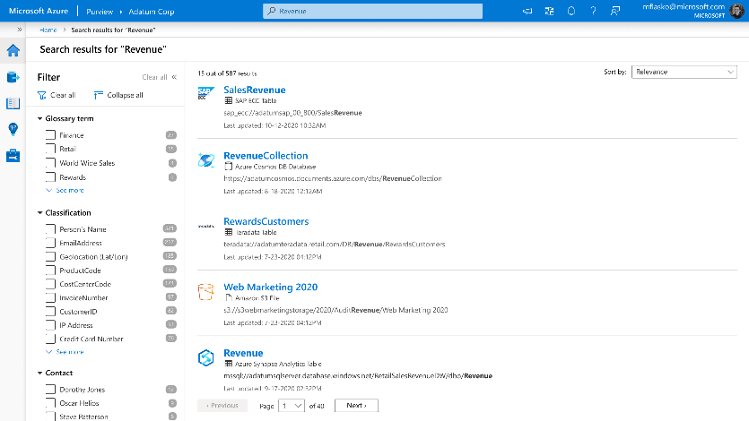
Azure Purview> Studio > Search results
Browse & Search
Search results by relevance
Benefits
Return relevant results without writing complex queries or applying advanced filters
Semantic search by understanding the context of every single word in search query and the intent (searching for one asset or exploration) of the user
Support for spell check, keyword suggestions, query expansion (synonyms, semantics) and content expansion (matching the keyword with things like glossary, classification and asset name)

Slide 31
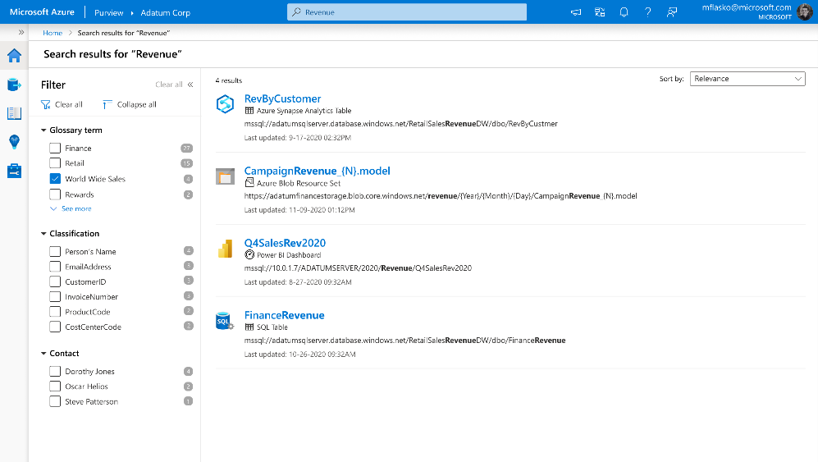
Azure Purview> Studio > Search results
Browse & Search
Filter search results by business terms, classifications, contacts

Slide 32
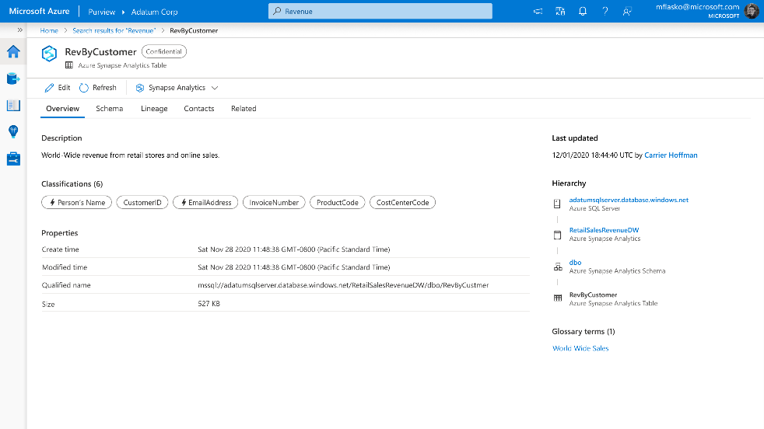
Azure Purview> Studio > Search results for ‘Asset Name’> ‘Asset Name’> Overview
Asset Overview
Discover operational, semantic and business information about a specific dataset
Semantic Metadata
Operational Metadata
Business Metadata

Slide 33
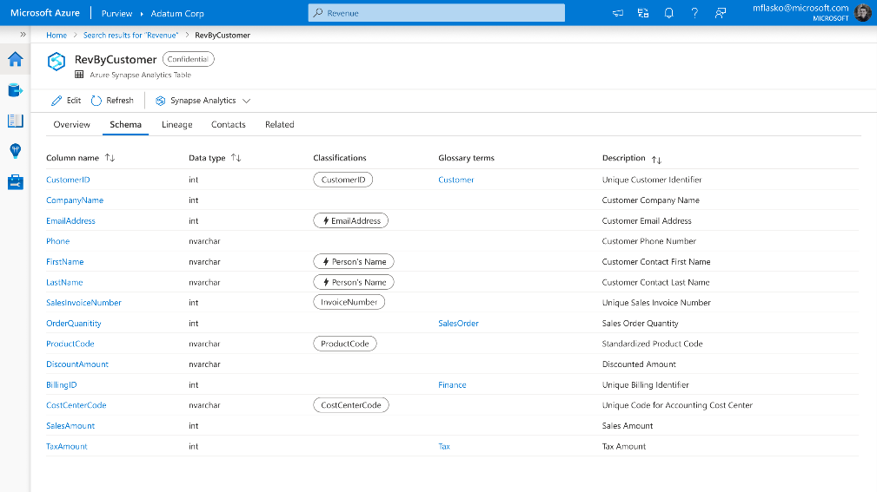
Azure Purview> Studio > Search results for ‘Asset Name’> ‘Asset Name’> Schema
Asset Schema
Discover technical, semantic and business information about a specific dataset

Slide 34
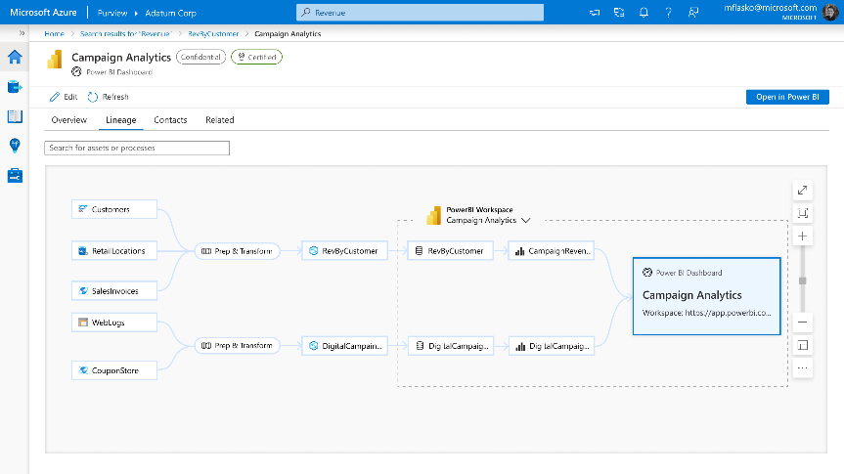
Azure Purview> Studio > Search results for ‘Asset Name’> ‘Asset Name’> Lineage
Asset Lineage
Trace lineage of data assets across the data estate
Benefits
Ensure data provenance with a visual representation of owners, sources, transformation, and lifecycle
Leverage support of Apache Atlas’s open-source Lineage APIs and built-in integrations with solutions such as Azure Data Factory, Azure Data Share and Power BI
Analyze impact of changes to data and understand dependencies visually.
Root cause analysis of failures by inspecting dependencies upstream and determine downstream impact

Slide 35
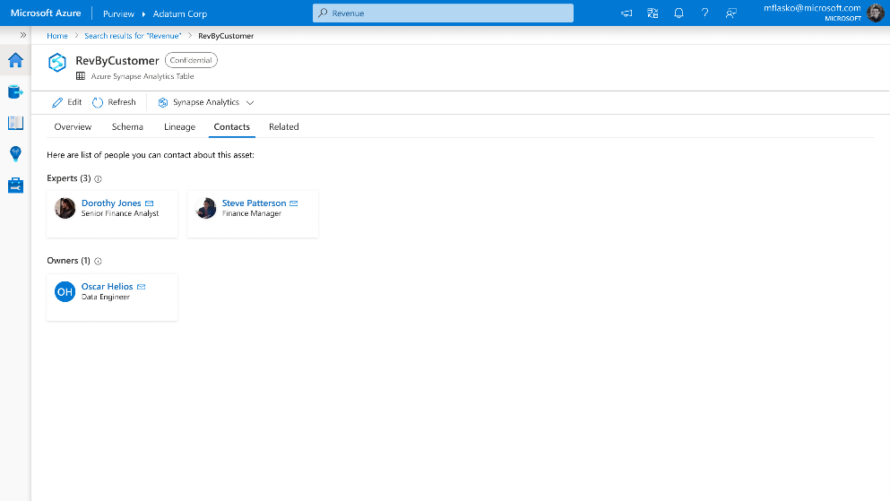
Azure Purview> Studio > Search results for ‘Asset Name’> ‘Asset Name’> Contacts
Asset Contacts
Identify experts and owners of the data asset

Slide 36
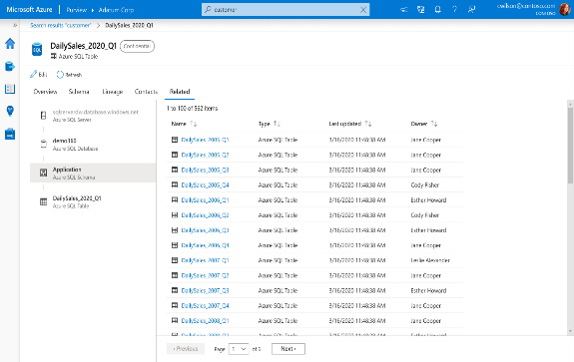
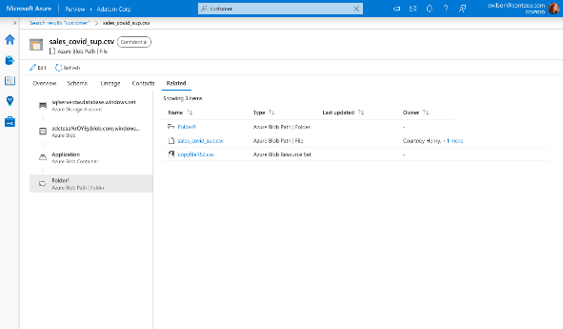
Azure Purview> Studio > Search results for ‘Asset Name’> ‘Asset Name’> Related
Asset Related
Browse assets by hierarchy. Works for unstructured, semi-structured and unstructured data
Unstructured Data
Browse Hierarchy
Structured Data
Browse Hierarchy

Slide 37

Purview Catalog Business Glossary (Search & Browse your data estate from a business lens)

Slide 38
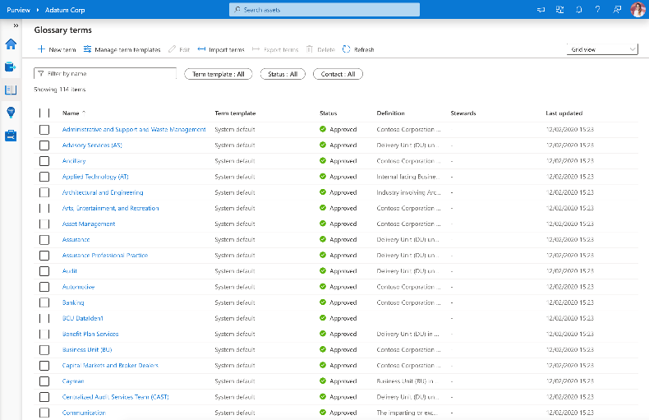
Azure Purview> Studio > Business Glossary
Business Glossary
Consistent and curated understanding of business terms and definitions
Benefits
Understand business context associated with data in the organization
Bulk Import glossary terms from existing data dictionaries easily
Flexible business terms definition with custom attributes per business domain
Browse & Search your data estate from a business lens

Slide 39
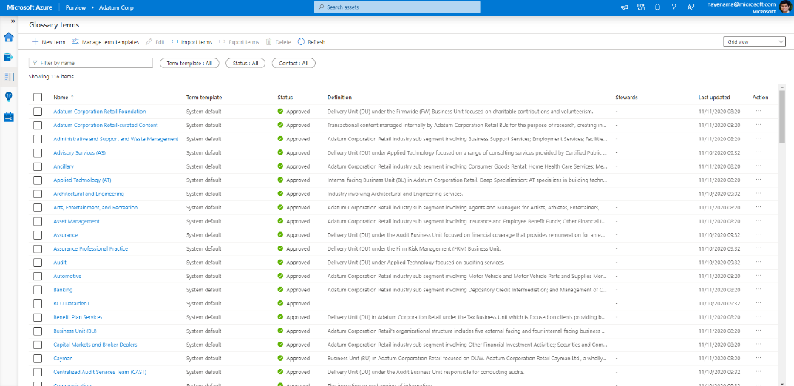
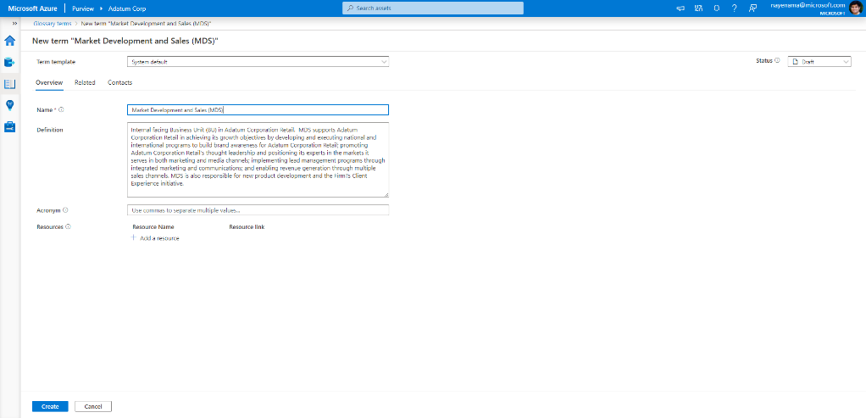
Azure Purview> Studio > Business Glossary > New Term
Business Glossary
Vocabulary for business users attached to assets in the catalog

Slide 40
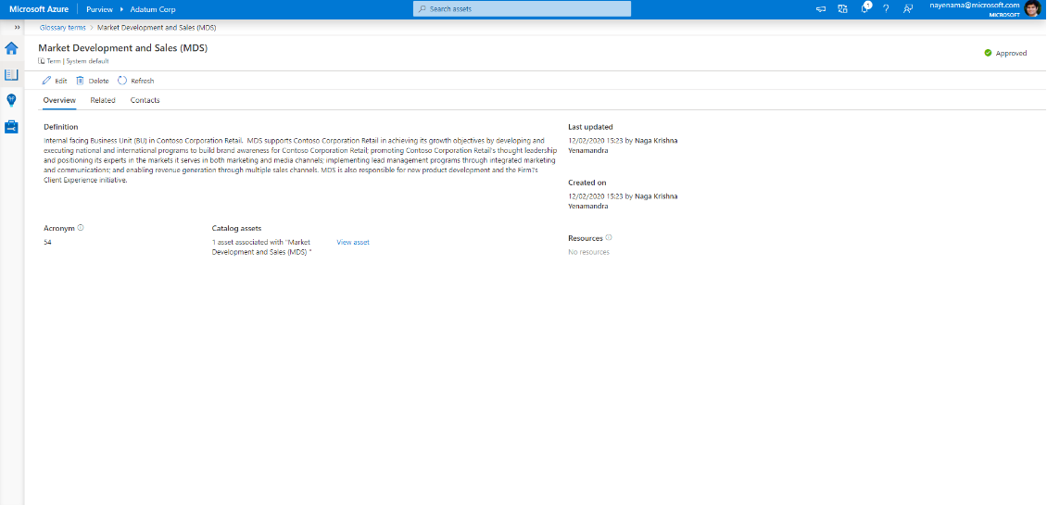
Azure Purview> Studio > Business Glossary
Business Glossary
Understand business context associated with data in the organization

Slide 41
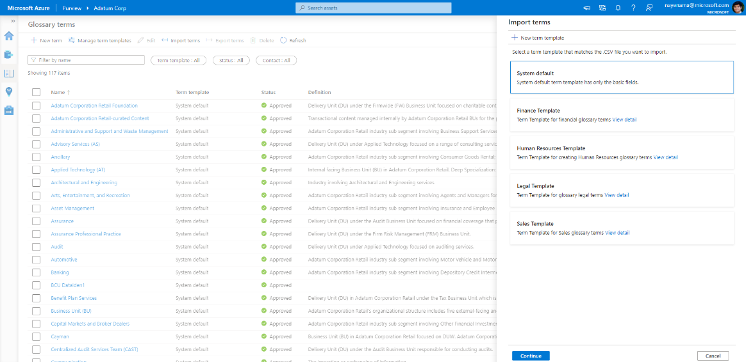
Azure Purview> Studio > Business Glossary
Business Glossary
Bulk import business terms from existing dictionaries

Slide 42
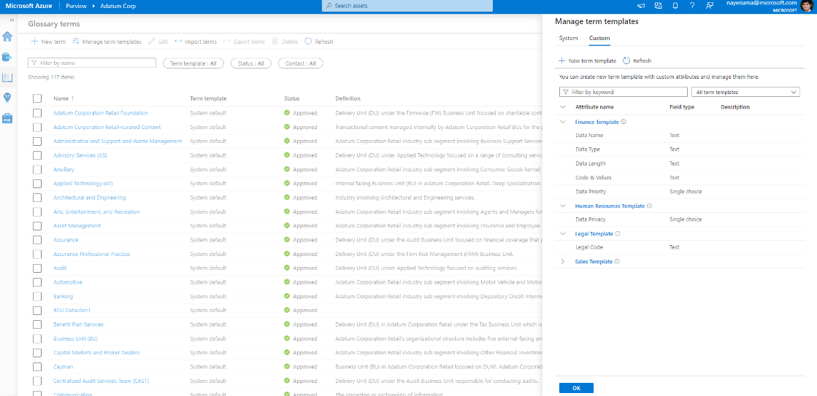
Azure Purview> Studio > Business Glossary
Business Glossary
Flexible business terms definition per business domain

Slide 43

Purview Insights Data Insights (Bird’s eye view of your Data Estate)

Slide 44
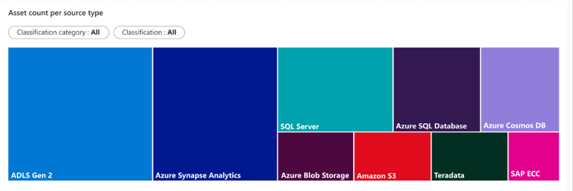
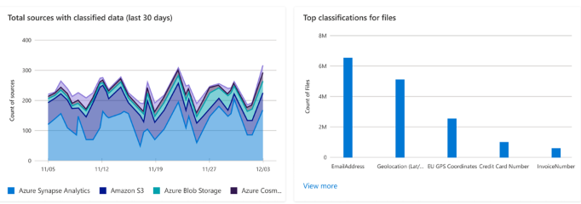
Azure Purview> Studio > Insights
Data Insights
Bird’s eye view of data landscape
Benefits
Intended to help users such as Chief Data Officers quickly understand their data estate at large and gain key insights such as where sensitive data resides
Asset Insights to see where all data resides across a range of data sources. Scan Insights to track successful, failed, cancelled scans over a period. Glossary insights to understand changes made to business terms and how much coverage glossary has over your data map
Sensitive data Insights to simplify compliance risk assessment across operational and transactional data sources. Assess risk and derive audit trails of data qualified by sensitivity and business relevance
Notes:
Azure Purview Insights offers a wealth of information to help you understand, catalog, govern, and secure your data. From the panoramic view across your data of Asset Insights to in-depth view to act on specific assets to understanding the sensitivity of data with Classification Insights and Sensitivity Labels. Insights is your one-stop shop to managing across the breadth of your company’s data estate.

Slide 45
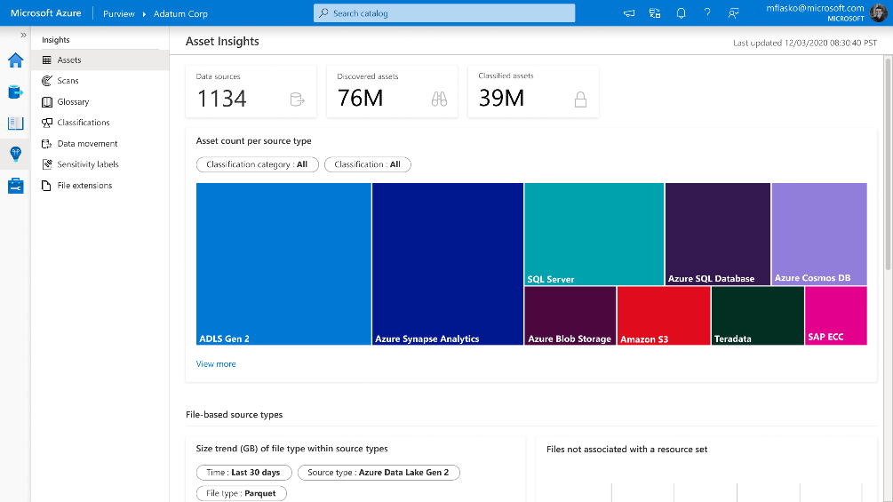
Azure Purview> Studio > Insights > Assets
Asset Insights
Understand distribution of data assets across a range of data sources & environments
Notes:
Asset insights provides a single view across the Purview data estate. This experience offers insights into the progression of data assets including how many data sources have been scanned, how many assets were discovered, and how many discovered assets were classified. You can select a system- or user-defined classification and view the distribution of assets by source type, for the classification.
For file-based assets (Azure Blob, ADLS Gen 1 and ADLS Gen 2), Asset Insights enables a deeper look into size and file type trends, as well as files not associated with resource sets. This enables you to quickly identify anomalies in data assets. For instance, if you have a specific resource set pattern for your ADLS Gen 2 account, use the “Assets without Resource set” graph to identify files that do not follow the resource set pattern. Asset Insights allows you to drill down and contact the asset owner to address the anomaly.

Slide 46
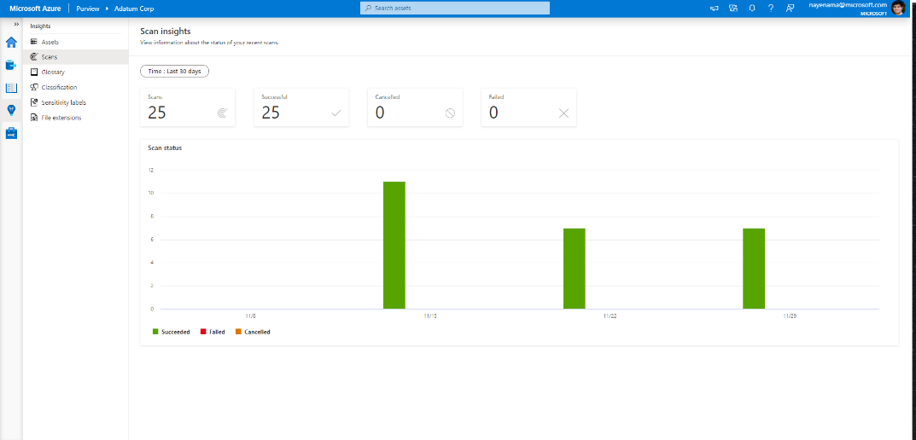
Azure Purview> Studio > Insights > Scans
Scan Insights
Number of successful, failed and cancelled scans over time
Notes:
Scan insights provides a view of scan progress across the last 30 days. This allows you to gain insights about scans and understand when scans are failing. Scanning sets the stage for the additional insights. With View more, you can see scan names by count of successful, canceled and failed scans. If you want to drill deeper, Insights can help you navigate to scan history to see exactly when the scans were run with a failed, canceled or successful outcome.

Slide 47
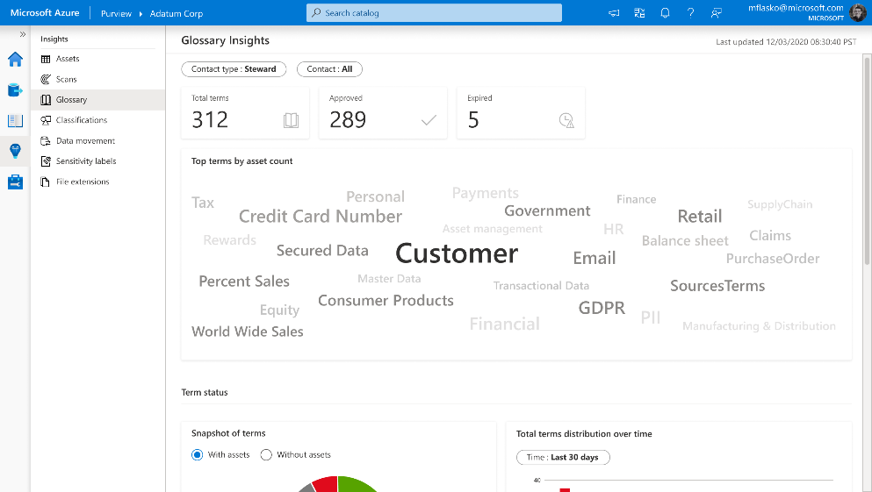
Azure Purview> Studio > Insights > Glossary
Glossary Insights
Understand changes made to business terms and assess how much coverage glossary has over the data map
Notes:
A glossary provides a vocabulary for business users to manage business terms attached to assets. Glossary Insights enables you as a business user, to understand total terms in the glossary, count of approved and expired terms and understand the usage of terms applied to assets. Glossary Insights also helps business users complete their glossary by showing terms with missing experts or stewards. With View more, you can see which terms are missing information and you can navigate to Glossary to remediate immediately.

Slide 48
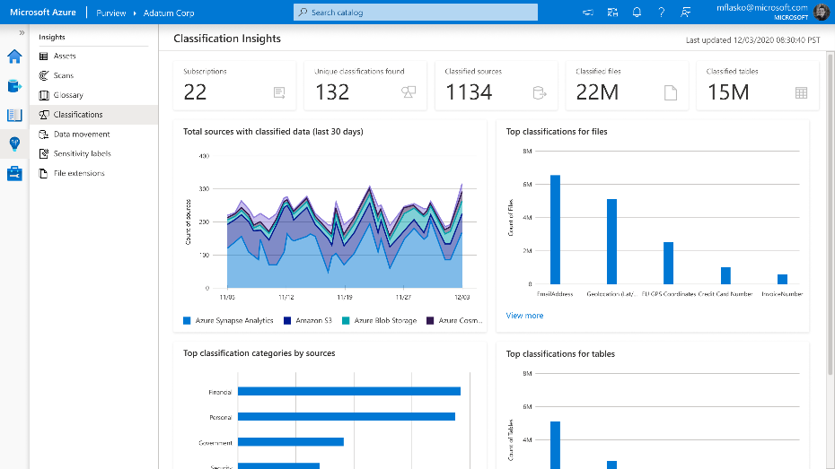
Azure Purview> Studio > Insights > Classifications
Classifications Insights
Understand what sensitive data exists across the data estate from various lens
Notes:
The Classification Insights report will help you, as a security or data officer to understand the types of information found in your organization’s data estate, and where classified data is located. In Azure Purview, classifications are used to help identify content of a specific type in your data estate. Classifications Insights showcases what set of assets contain sensitive information types like Credit Card information, SSNs and email addresses. Use the report to identify content with specific classifications and understand required actions, such as adding additional security to the repositories, or moving content to a more secure location.

Slide 49
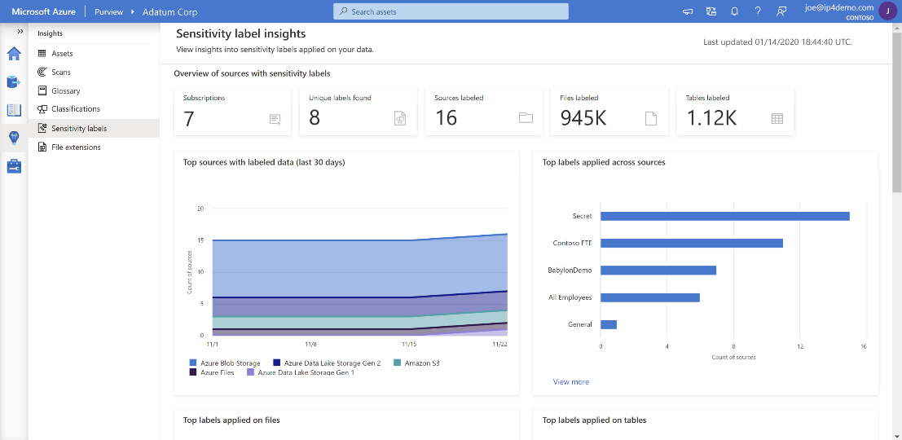
Azure Purview> Studio > Insights > Sensitivity labels
Sensitivity Labels Insights
Understand what sensitivity labels have been applied across the data estate
Notes:
Sensitivity labels from the Microsoft Information Protection framework let you classify and protect your organization's data, while making sure that user productivity and their ability to collaborate isn't hindered. With Azure Purview, you can now apply these sensitivity labels to your Azure assets and gain insights into the state of your data. Sensitivity labels insights provides you an overview of the sensitivity labels applied in your data estate, as well as a drilldown to the labeled files and databases.

Slide 50
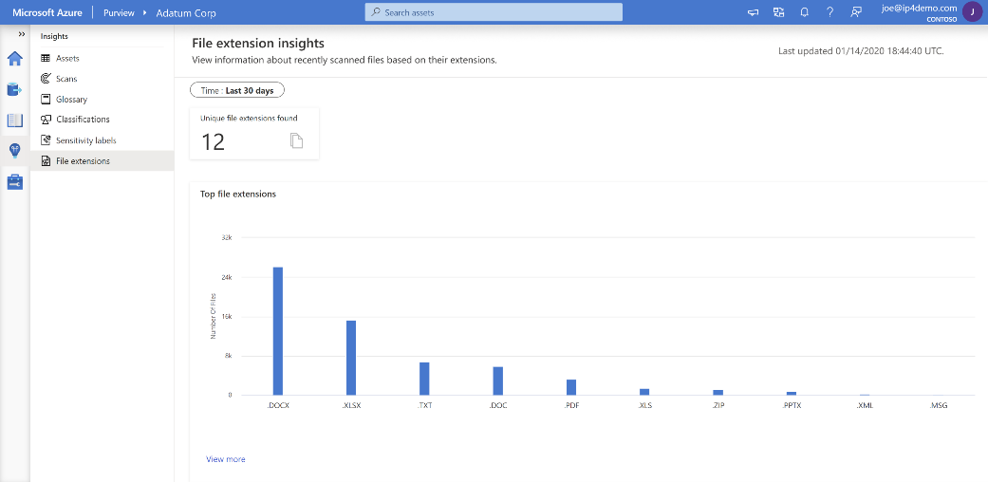
Azure Purview> Studio > Insights > File extensions
File Extensions Insights
Recently scanned files based on their extensions
Notes:
After scanning your assets, Azure Purview will detect the file types found in your data estate and provide you with details about each file type as part of File Extensions Insights report. Use the report to identify how many different file types you have, how many files of each type are found, where those files are, and whether they are content scannable for sensitive data or not.

Slide 51

Purview Studio Management Center

Slide 52
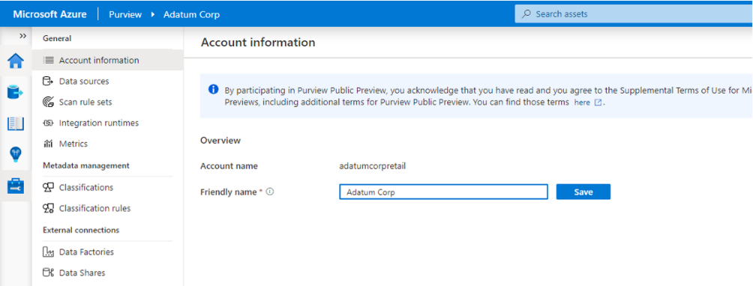
Management Center
Azure Purview > Management Center
Provides ability to manage account information, scan rulesets, custom classifiers, integration runtimes & external connections

Slide 53
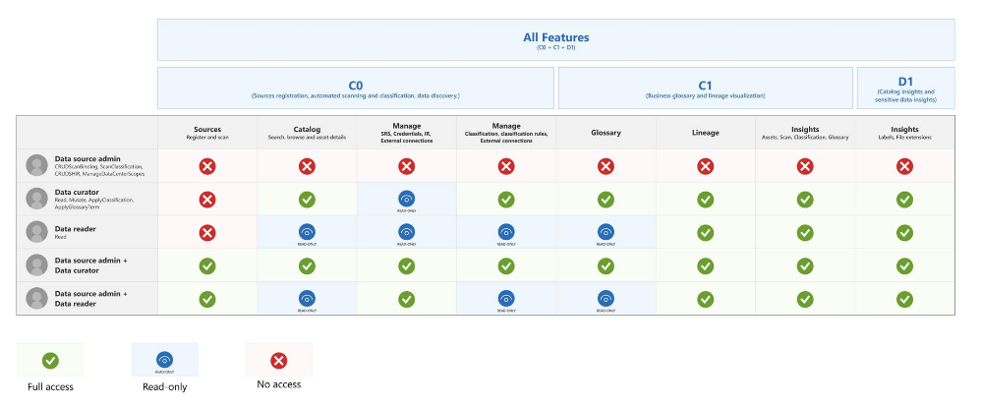
Management Center
Azure Purview > Management Center
Management Center table of contents based on user roles
For data curator, the buttons are Account information, Classification, Classification Rules, Metrics, Access control, Data factories and Data share connections.
For data reader, the featured buttons are Account information, Classification, Classification Rules, Metrics, Access control, Data factories and Data share connections.
For data source administrator + data curator/reader, the featured buttons are Account information, Scan rule sets, Classification, Classification Rules, Integration run time, Metrics, Access control, Credentials, Data Sources, Data factories and Data share connections
For data source administrator, no access to Purview Studio.

Slide 54
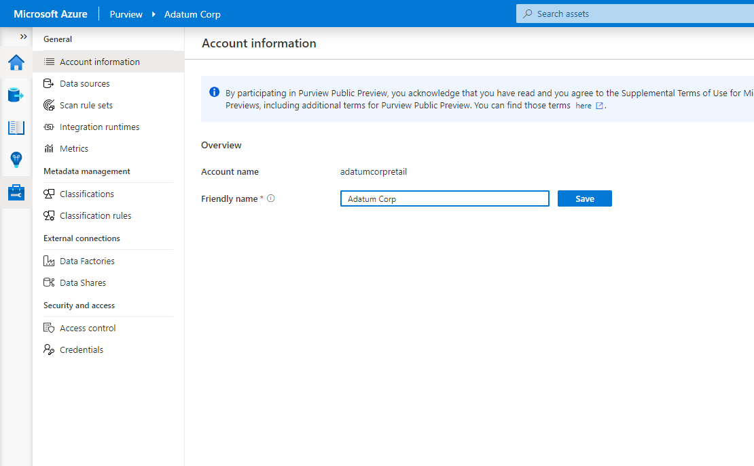
Management Center – Account Information
Azure Purview > Management Center > Account Information
See Purview Account information and set a friendly name for Purview account

Slide 55
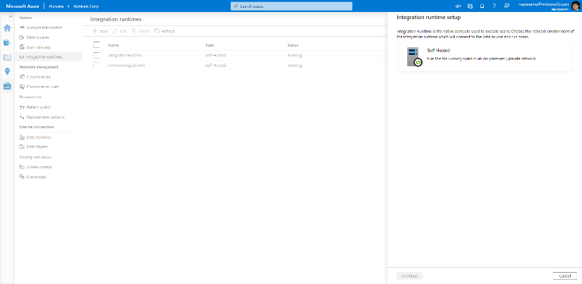
Management Center – Integration runtimes
Azure Purview > Management Center > Integration runtimes
Integration runtimes are the compute infrastructure used by scanners to provide automated data scanning, lineage and classification capabilities across different network environments including on-prem environments
Benefits
Offers Self-Hosted Integration Runtime
Self-Hosted Integration Runtime– use compute resources in on-premises machine or a VM inside private network
Notes:
Need to explain and why needed
Check with Gaurav

Slide 56
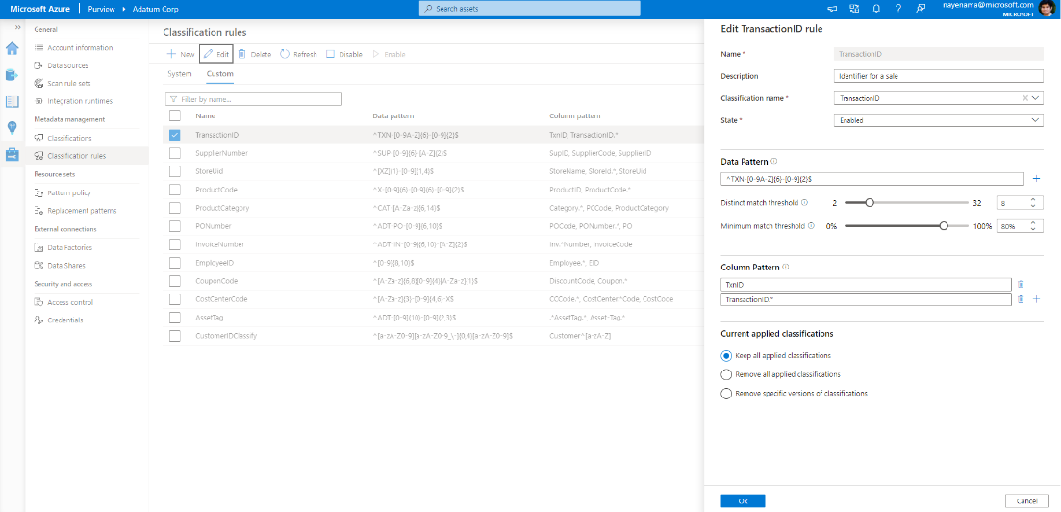
Management Center – Custom Classification rules
Azure Purview > Management Center > Classification rules > Custom
Define your own data pattern along with thresholds to reduce false positives

Slide 57
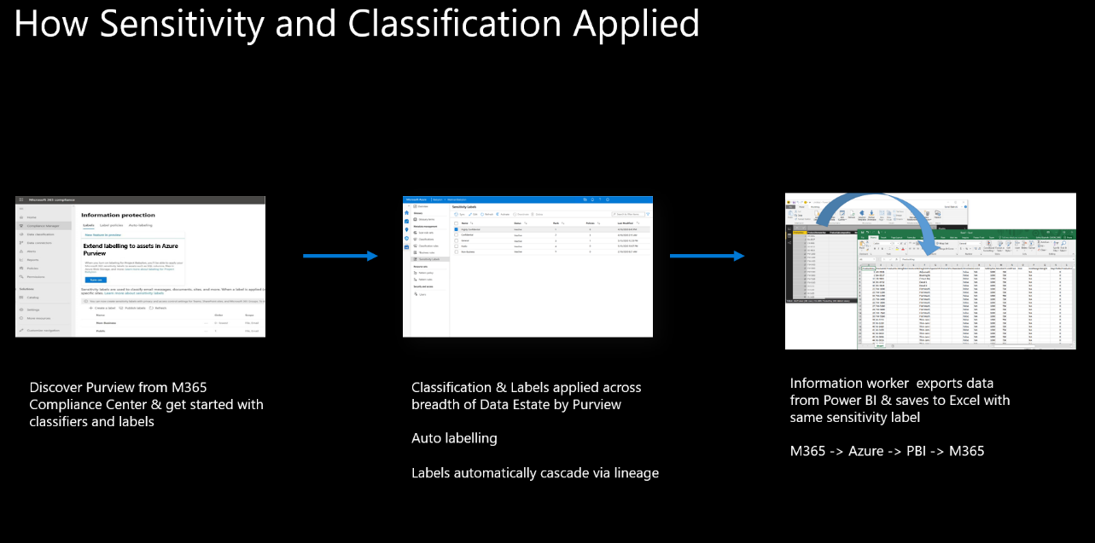
Azure Purview > Scenario
Available Today (Preview)
Future

